Slide 1
Line Following Robots

Slide 2
Objectives
Move in straight lines
Basic Python will be learn through examples

Slide 3
Alphabot 2
This mobile robots have only one sensor – infra red array.
black line absorb infra red while bright surface reflect infra red.
infra red travel in speed of light give almost zero delay between transmitter and receiver.

Slide 4
What you going to do in this section
https://www.youtube.com/watch?v=e3iG1YwLLdQ&list=PLFrD3-dtN05EM5r5u3bSLUqNLjTn92jNp&index=2&t=0s

Slide 5
Step by Step
All Programs -> Python -> IDLE
File -> New File

Slide 6
Test Line Tracker
from alphabot2 import motor,line_tracker
import time
# IP adddress of your robot
address = "192.168.0.100"
# create line tracker object
lt = line_tracker.line_tracker(address)
# start reading data from server
lt.start()
for i in range(100):
# stop for one second
time.sleep(1)
if lt.data==0:
continue
# lt.data is an array with 5 elements
print(lt.data)
# remember to stop the socket connection
lt.stop()
To run the code:
F5
Run -> Run Module

Slide 7
Test Motor (remember to put on floor before execution)
from alphabot2 import motor,line_tracker
import time
address = "192.168.0.100"
mot = motor.motor(address)
# below is the general function's parameters and range
# mot.command(direction,speed,duration)
# parameters:
# direction: "forward","backward","left","right","set_left_speed","set_right_speed","stop"
# speed: 0-100
# duration: second
# run forward at 20 speed for 5 seconds
mot.command("forward",20,5)
# set speed of left and right and ask robot to move forward
mot.command("set_left_speed",10)
mot.command("set_right_speed",10)
mot.command("forward")
time.sleep(5)
# stop moving , speed set to zero
mot.command("stop")
time.sleep(1)
# set speed of left and right and ask robot to move backward
mot.command("set_left_speed",10)
mot.command("set_right_speed",10)
mot.command("backward")
time.sleep(5)
mot.command("stop")
time.sleep(1)
# spin turn
mot.command("set_left_speed",10)
mot.command("set_right_speed",10)
mot.command("left")
time.sleep(5)
mot.command("stop")
time.sleep(1)
# spin turn
mot.command("set_left_speed",10)
mot.command("set_right_speed",10)
mot.command("right")
time.sleep(5)
mot.command("stop")
# remember to stop the socket connection
mot.stop()

Slide 8
Let’s imagine how this robot see

Slide 9
Let’s talk about calibration
Notes:
use the average / mean as threshold

Slide 10
Let’s Talk about Rules
forward
left
right
u-turn
stop

Slide 11
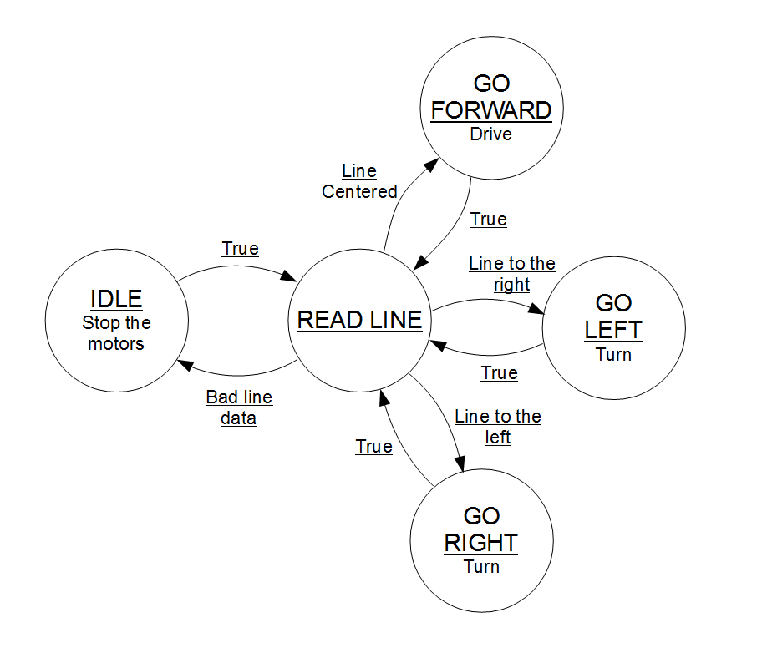
Let’s Write down all the rules!
Write down or draw your rules in a pieces of paper
use while loop
use for loop
use if else condition
Notes:
L

Slide 12
Let’s program it!
I will help you on translating your writing to code

Slide 13
Demonstrations

Slide 14
Any Questions?

Slide 15
My Questions
Q1: Does the alphabot know whether it is moving after you give it a command?
Q2: How to let/ make alphabot know whether it is moving after you give it a command?
Q3: while alphabot is walking, it see
follow by . What type of route you think it encounter?
Q4: How many combination of IR sensors available?
Q5: How many combination of an Image pixel available? Assume a 640x480x3 image with 256 color
Notes:
Q1 No feedback
Q2 another sensor, vision, encoder,
Q3
Q4 2**5
Q5 see next page

Slide 16
Q5
256**(480*640*3)

